Slide 1

By -: Manas Ranjan
Sr. Full stack developer @paddleboat

Slide 2
content
Understanding PWAs
Implementing PWAs with React.js
Leveraging ServiceWorker.js for PWAs
Register ServiceWorker.js in React app
How to caches the Build files for offline functionality
Fetch all caches data to render during unavailability of network.
How to forward port for localhost to test in android devices using android studio.
Allow push notifications according to your usecase.

Slide 3


Slide 4
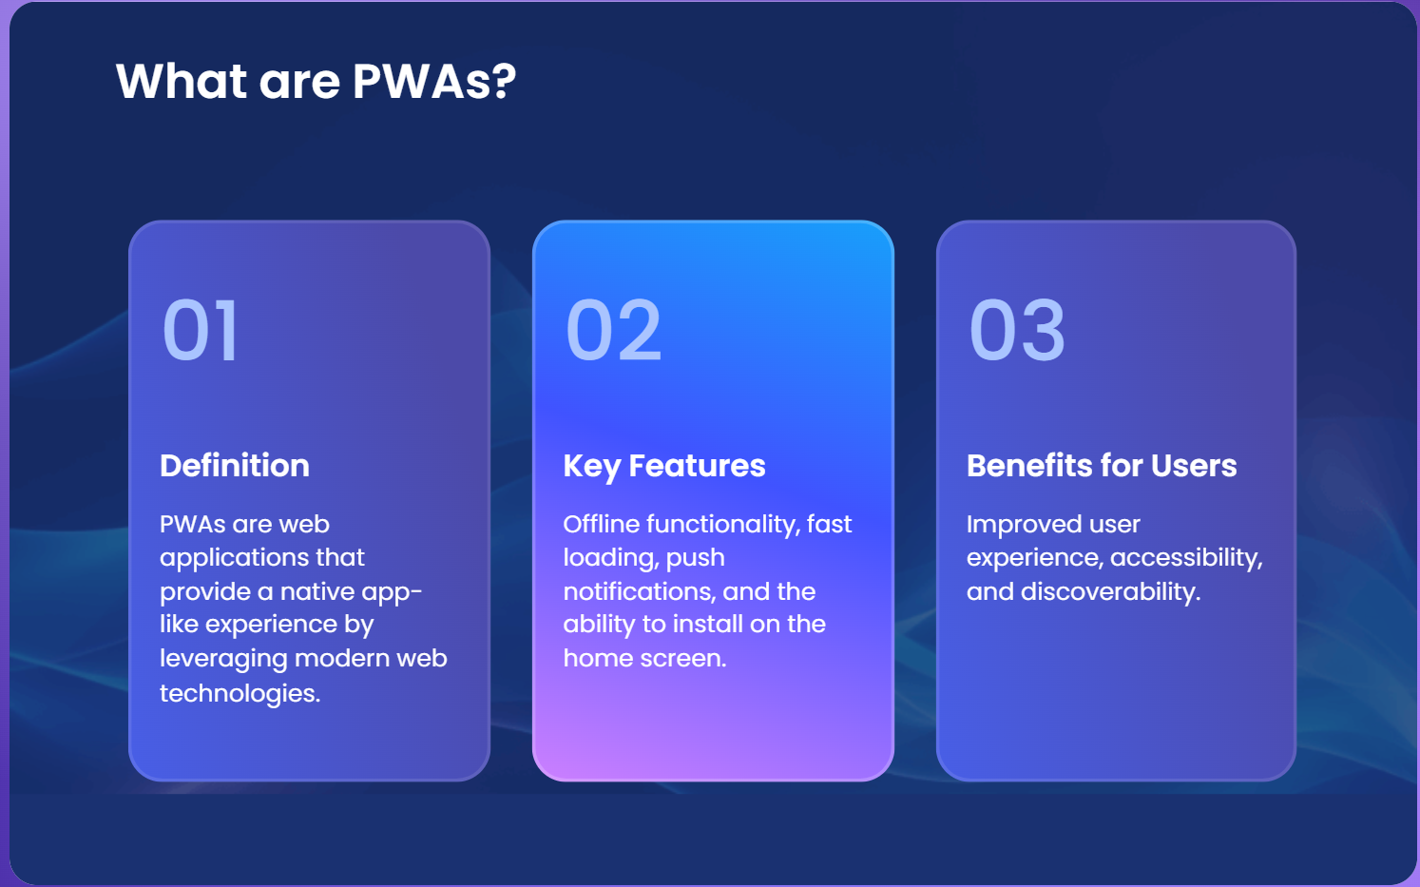
A web application + additional powers

Slide 5
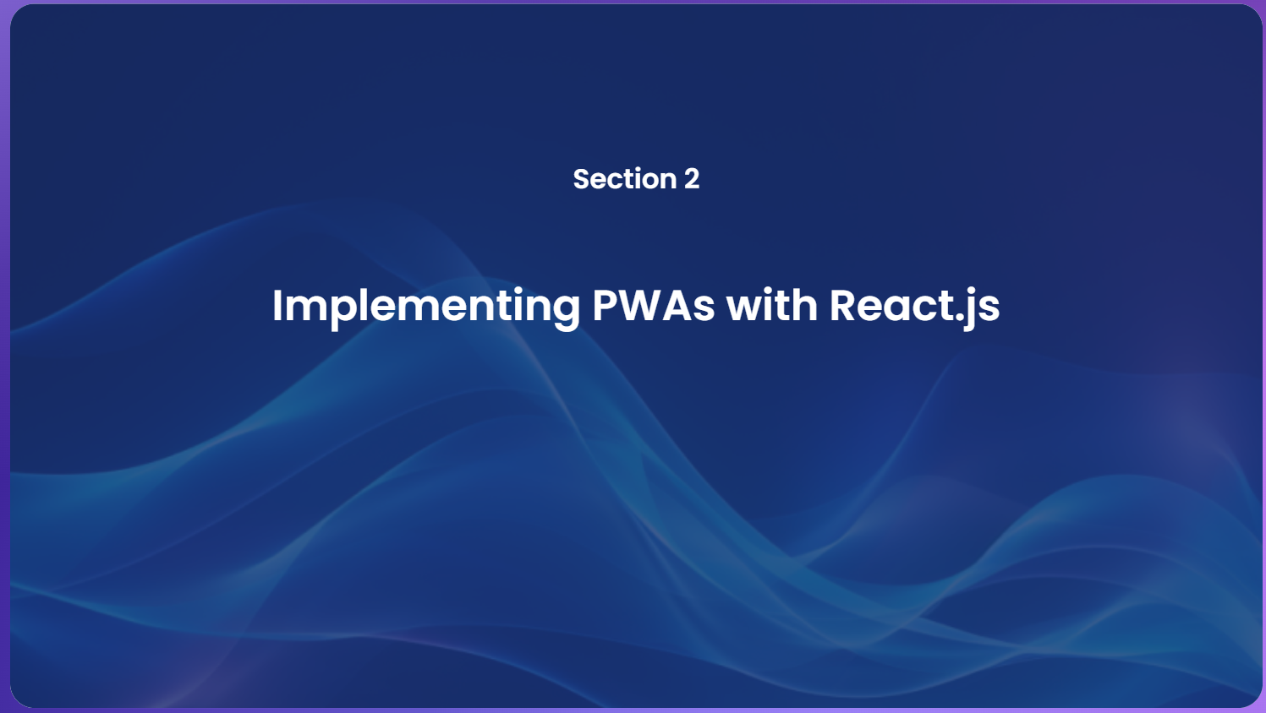

Slide 6
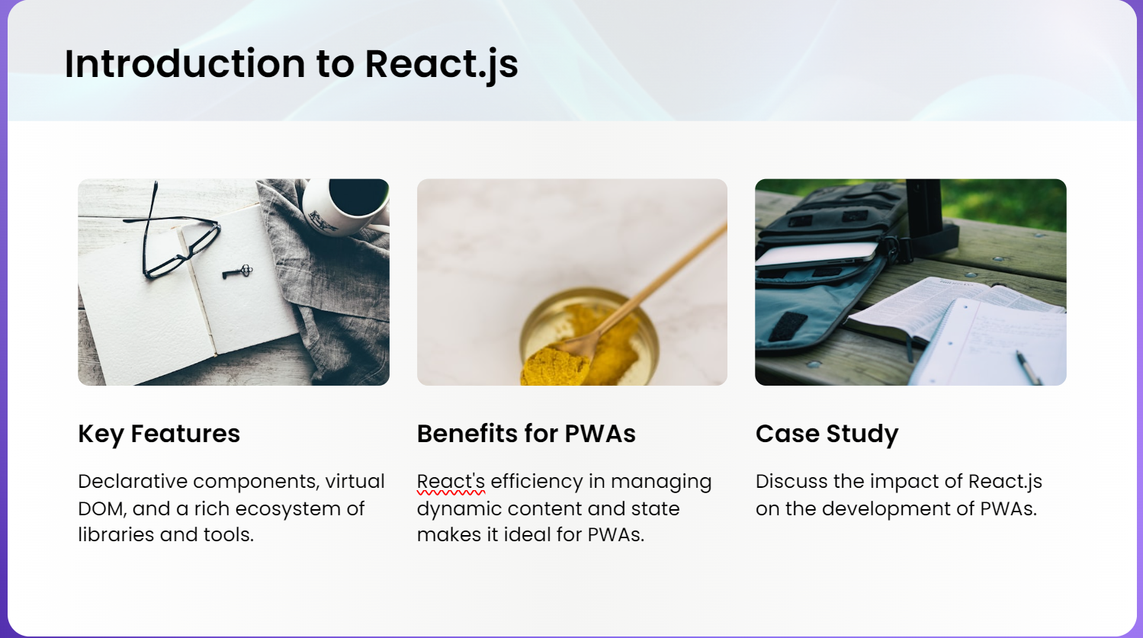

Slide 7
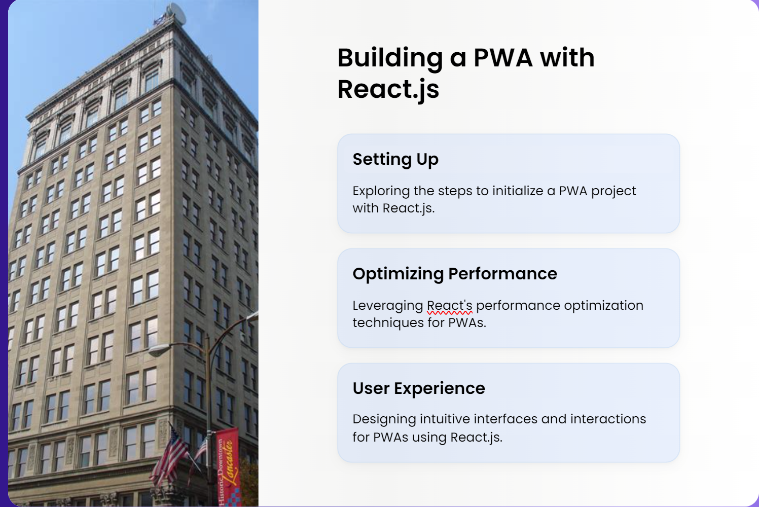

Slide 8
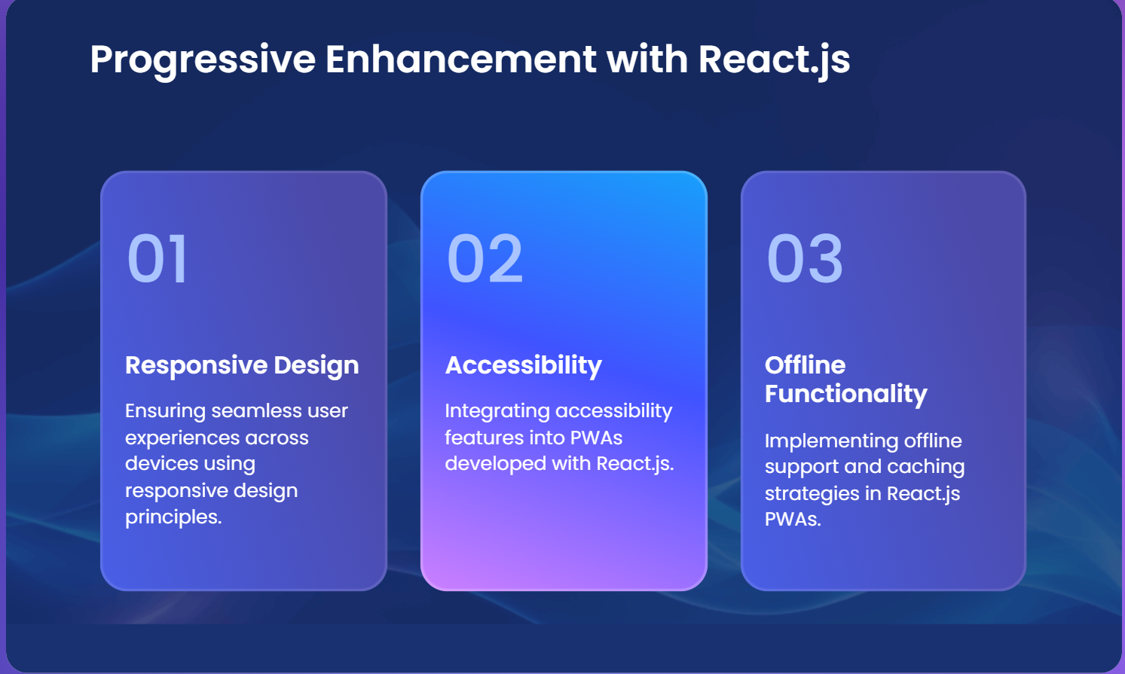

Slide 9
Some more key points
Push Notifications
Up to date in Background
Can use GPS and access hardware component

Slide 10


Slide 11
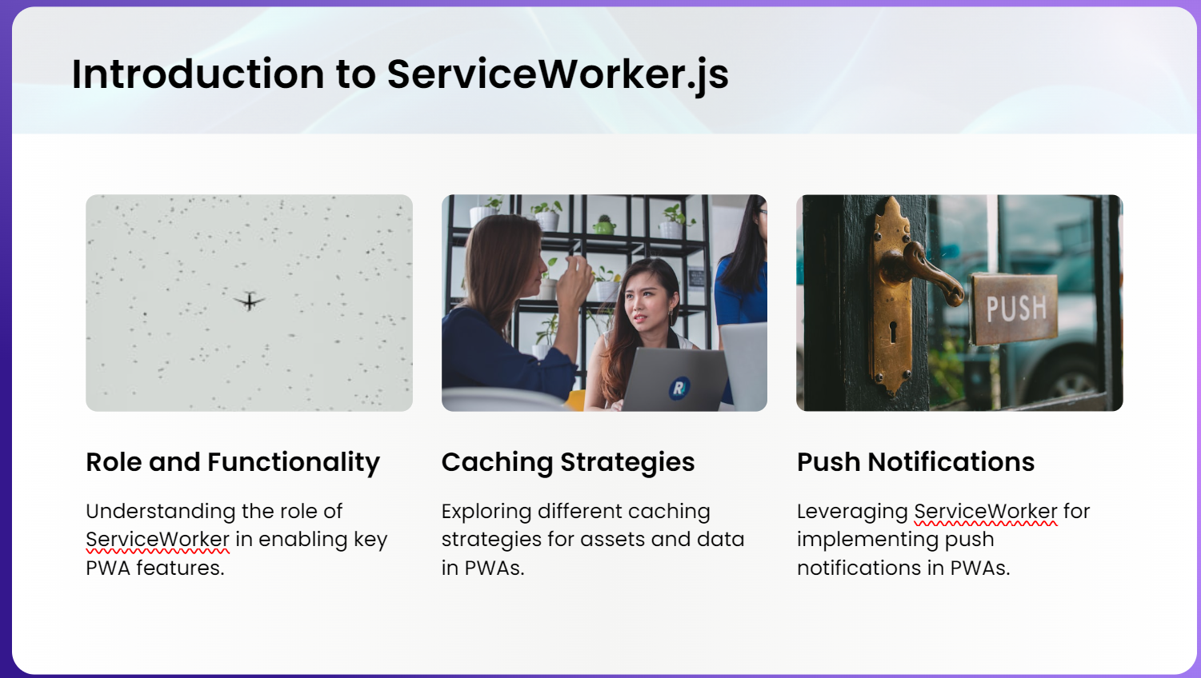

Slide 12
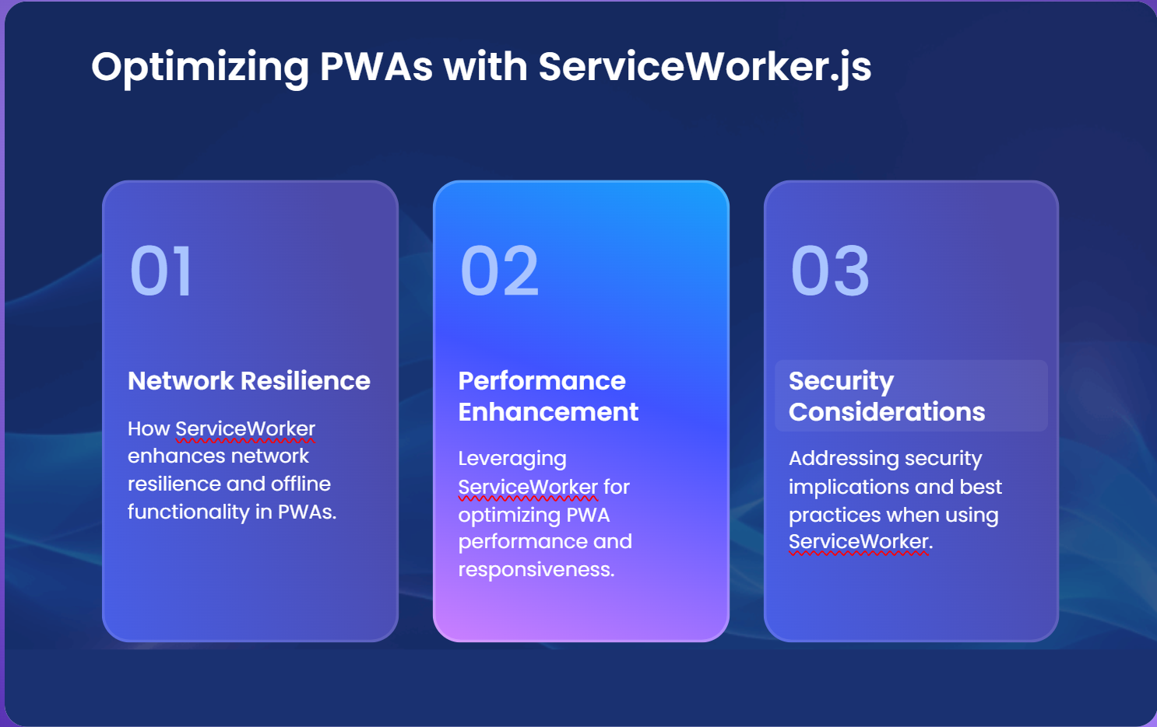

Slide 13
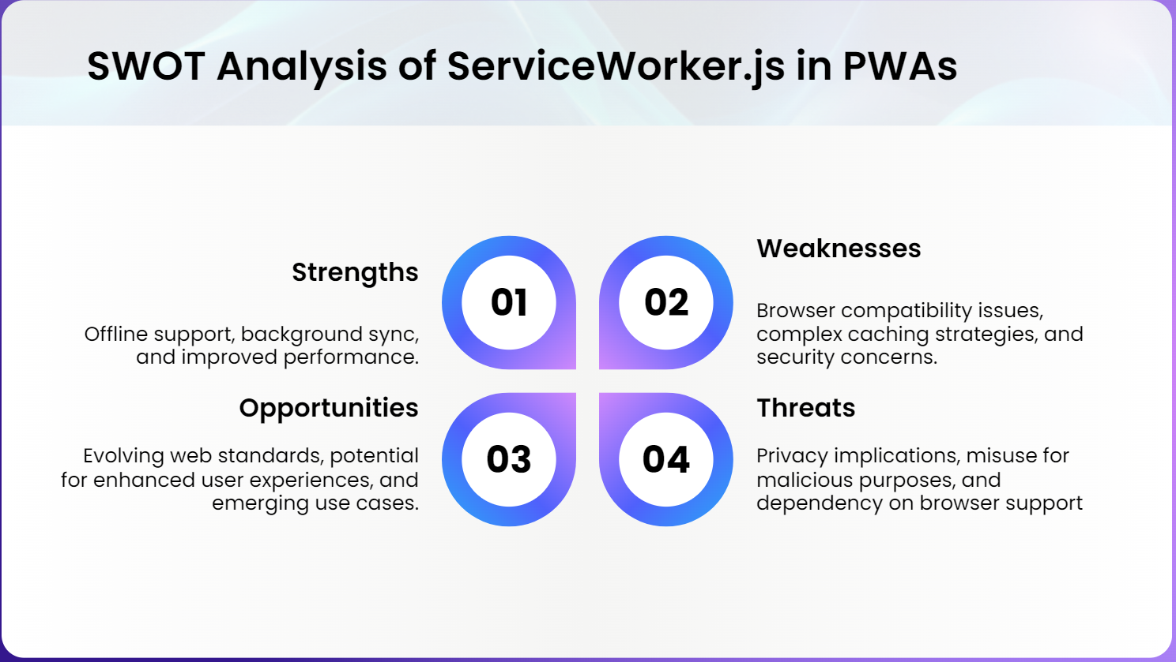

Slide 14

Lets jump into the code

Slide 15
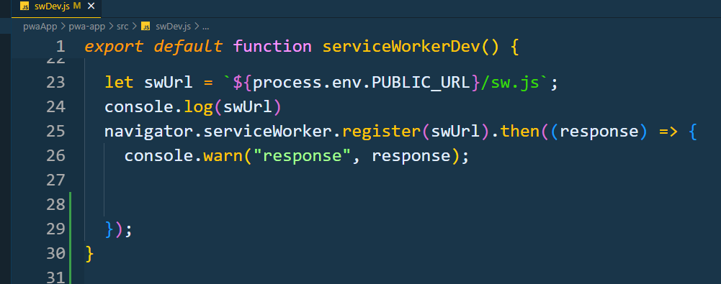
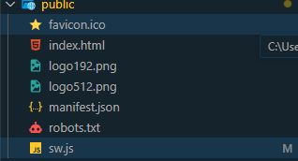
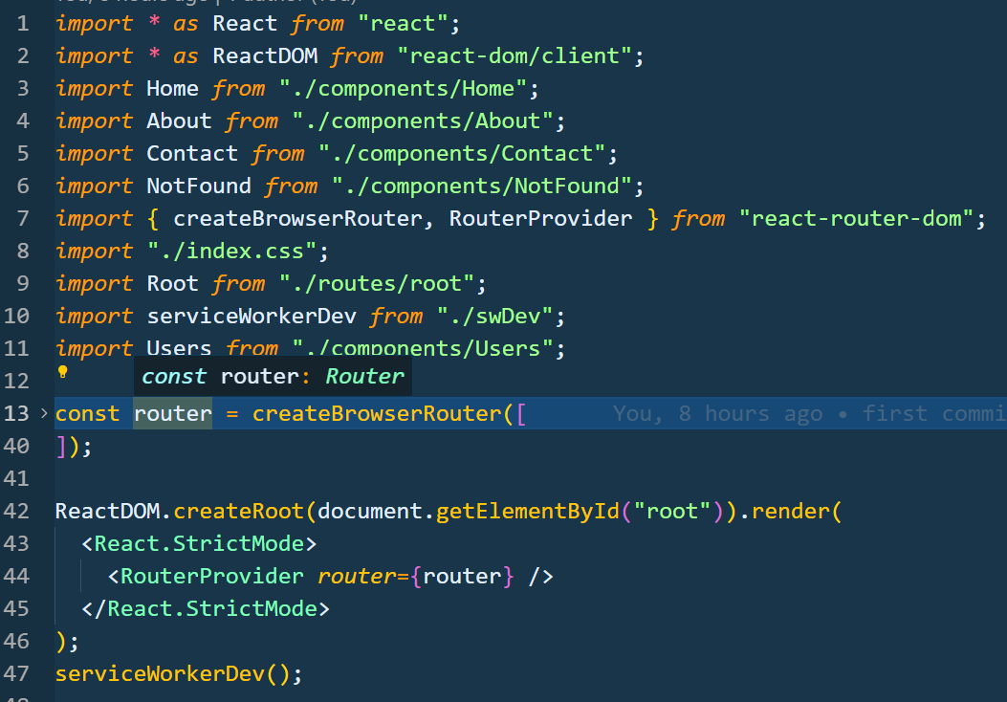
Step 1: Register a service worker file

Slide 16
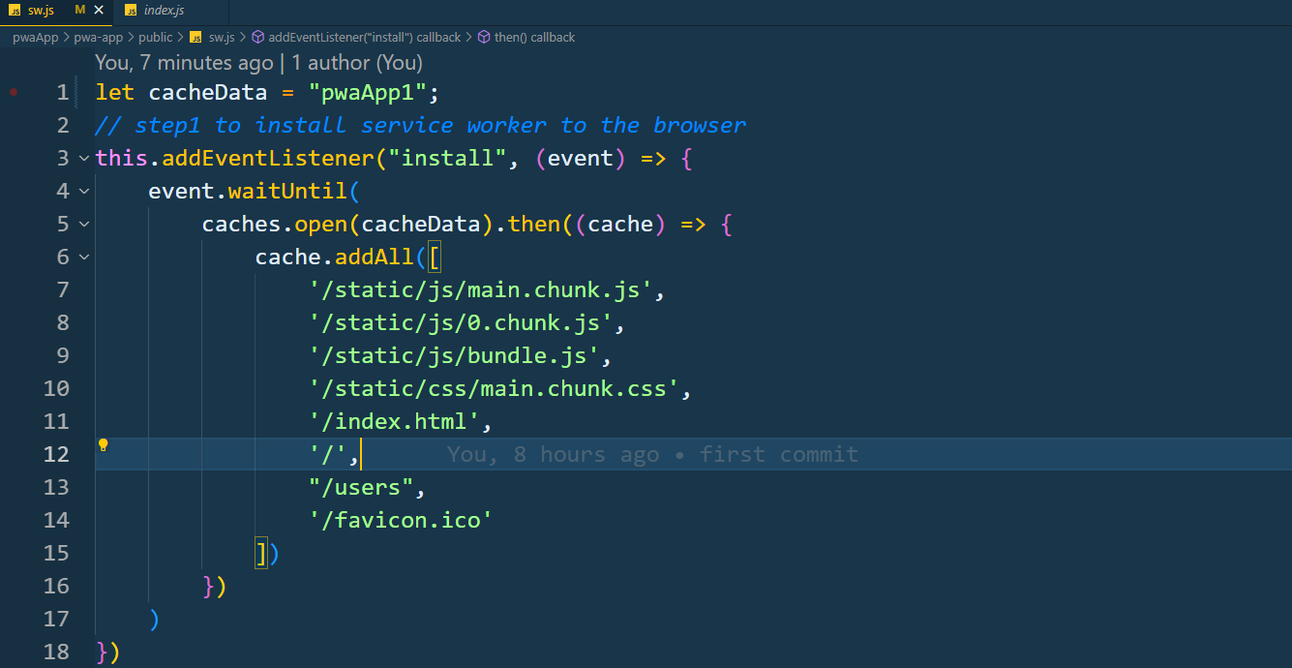
Step2: Cache all the build files and routes

Slide 17
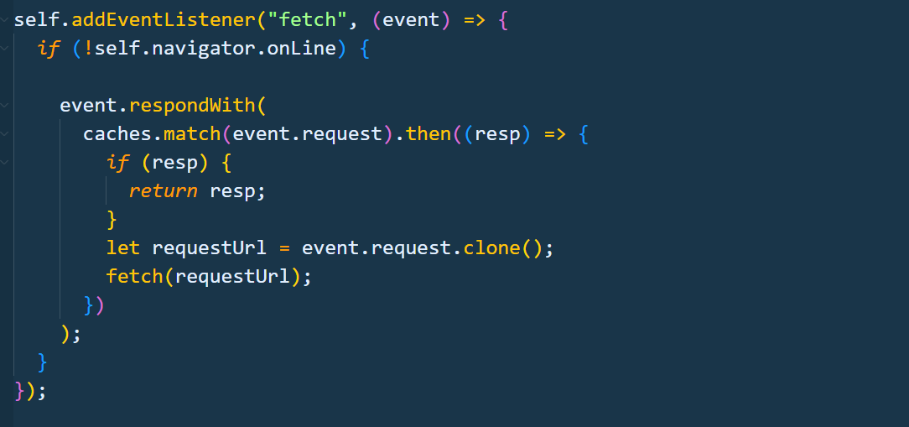
Step3: Fetch all caches

Slide 18
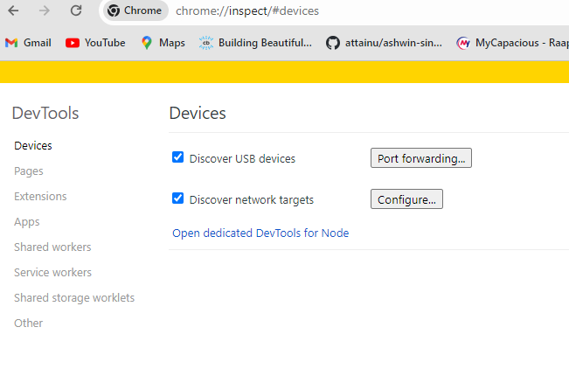
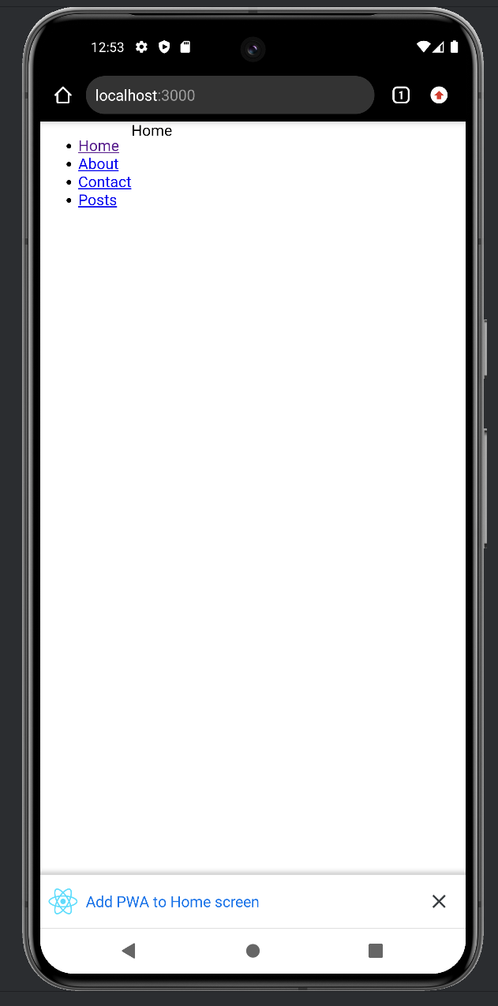
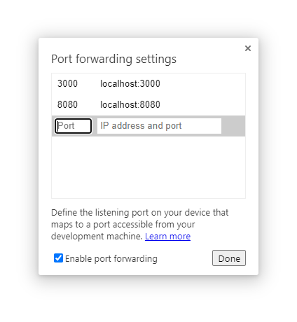
Web app feel like native app

Slide 19
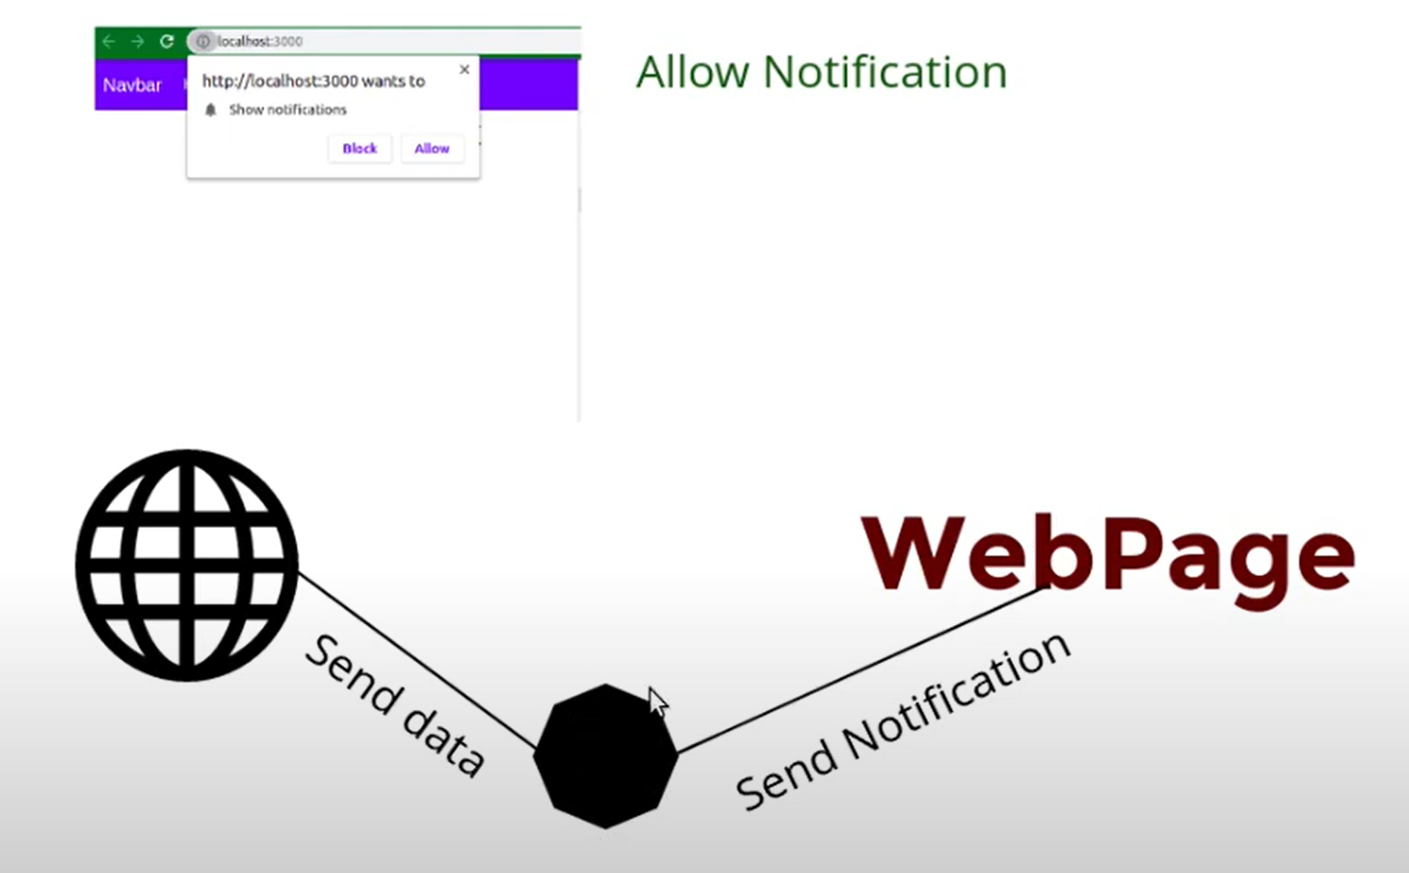
How to allow push notifications

Slide 20
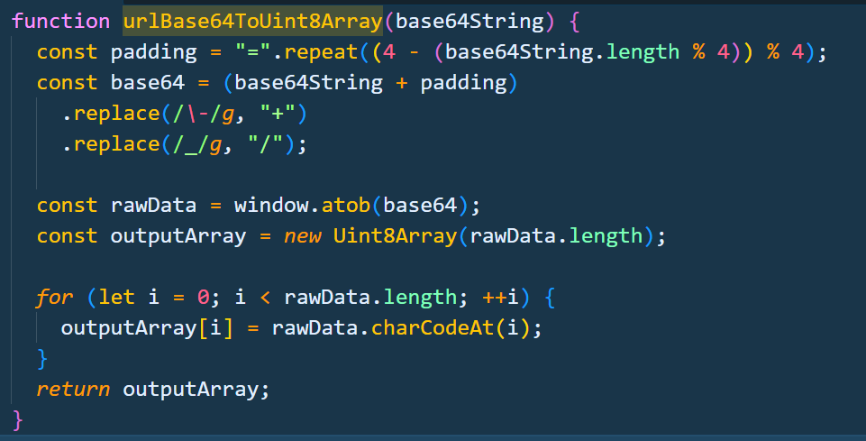
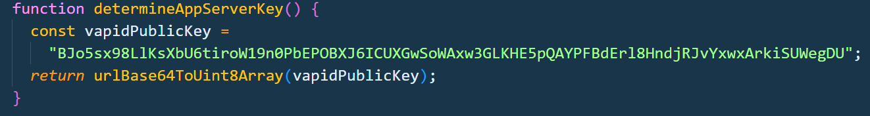
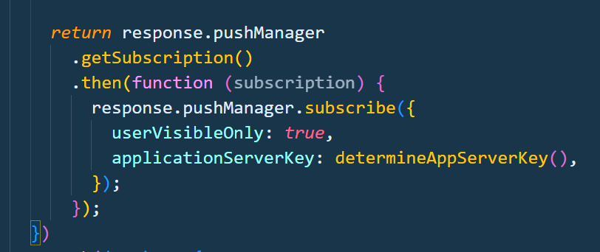
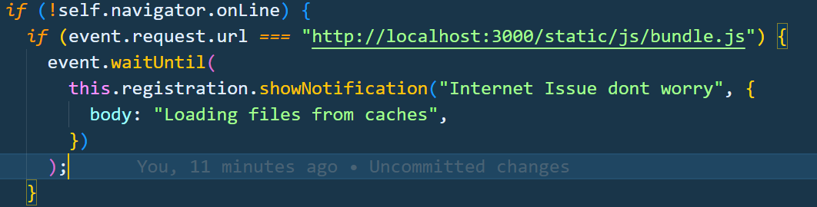
Step 4: Push Notification codebase
Step1: Generate VAPI key for your server (Voluntary application server identification) and validate by decoding it
Step2 : create subscription for your server using server key and create custom notification

Slide 21
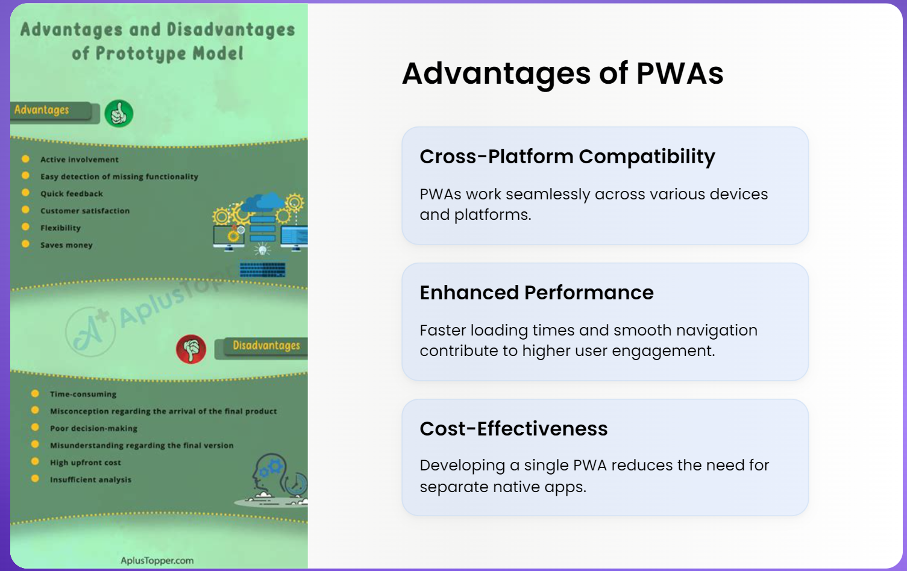

Slide 22


Slide 23
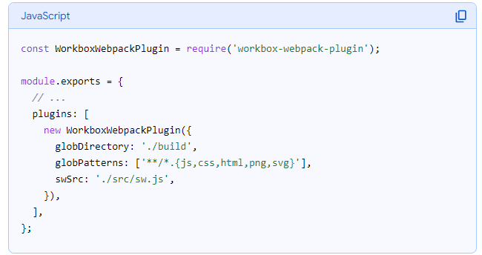
Simpler approach

Slide 24
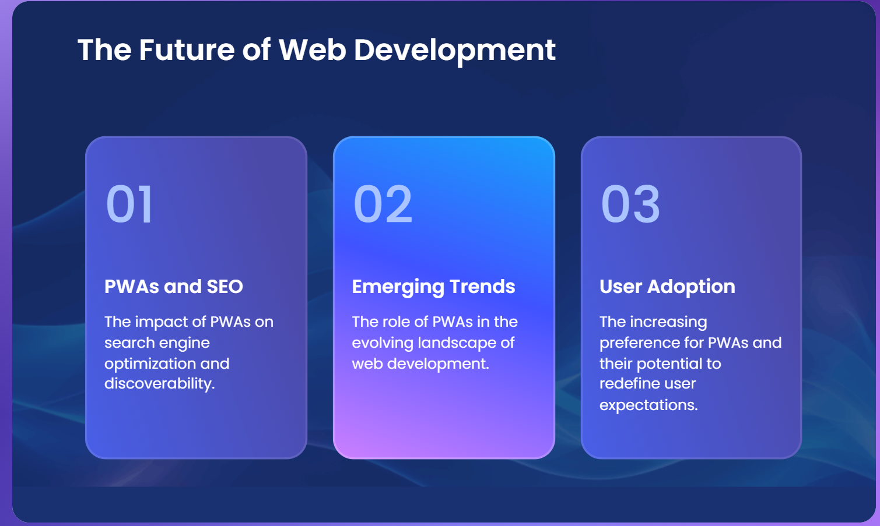

Slide 25




